Slide 1





COHESIVE DEVICES
Prepared by Nancy Anjani

Slide 2
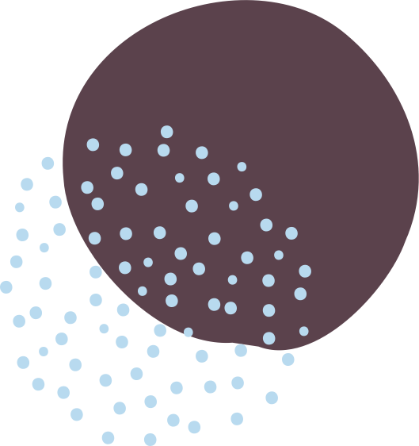


What are Cohesive Devices?
Words or phrases that show the relationship between paragraphs or sections of a text or speech.
Prepared by Nancy Putri Anjani

Slide 3

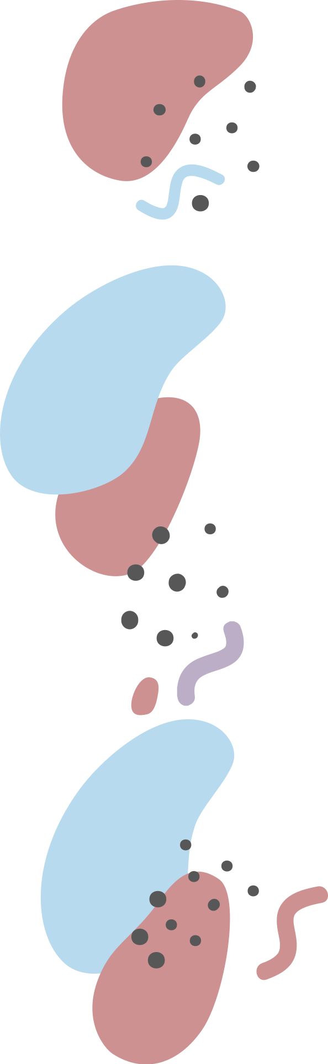
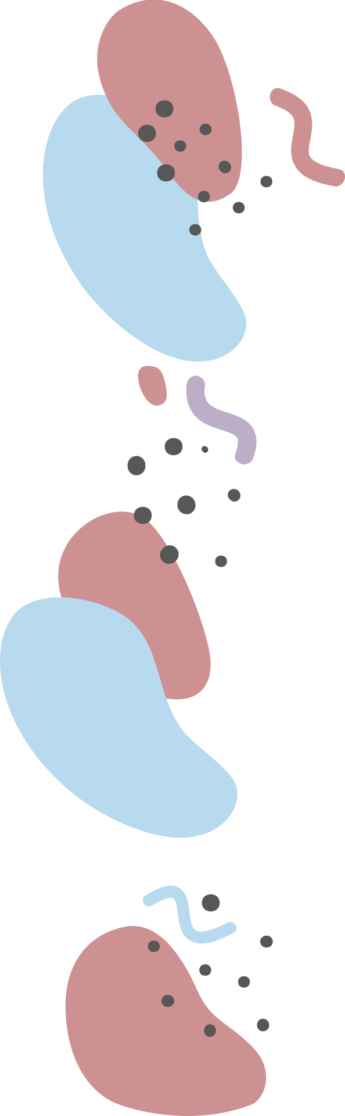
Also known as:
Transitional Words
Linkers
Connectors
Linking Words
Discourse Markers
Prepared by Nancy Putri Anjani

Slide 4


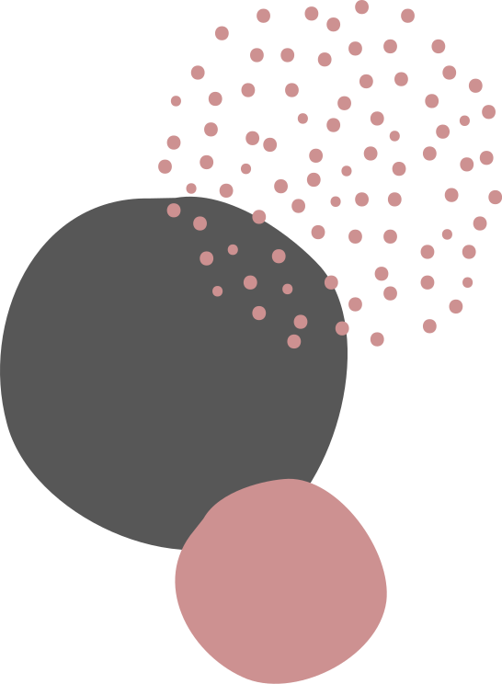
Conjuntions
OPERATE WITHIN SENTENCES
Mount Kilimanjaro is on the Equator, but it has a covering of snow
Mount Kilimanjaro is on the Equator. Nevertheless, it has a covering of snow
Connectors
OPERATE BETWEEN SENTENCES
Prepared by Nancy Putri Anjani

Slide 5


Cohesive Devices
PURPOSES
Prepared by Nancy Putri Anjani

Slide 6
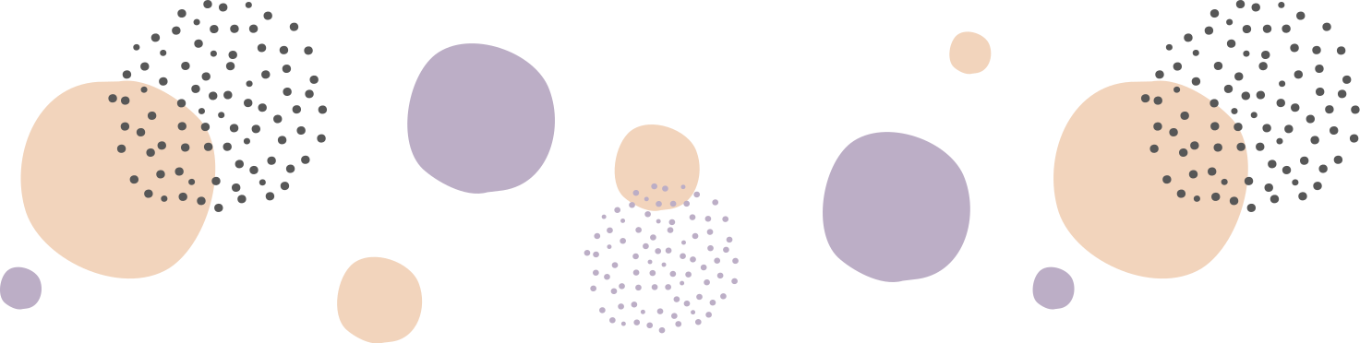
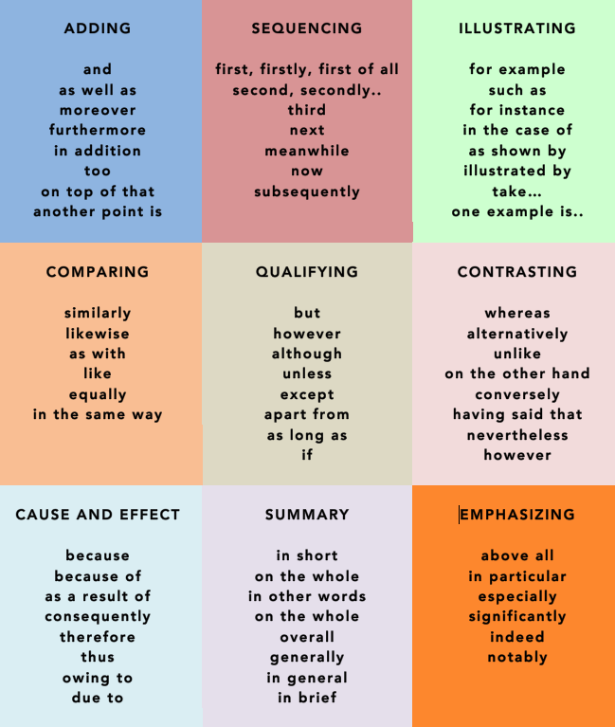
Prepared by Nancy Putri Anjani

Slide 7
Prepared by Nancy Putri Anjani

Slide 8
Prepared by Nancy Putri Anjani

Slide 9

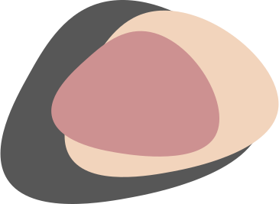
LEXICAL COHESION
BASED ON LEXICAL CONTENT
Methods of Cohesion
GRAMMATICAL COHESION
BASED ON STRUCTURAL CONTENT
Prepared by Nancy Putri Anjani

Slide 10



Cohesive Devices
TYPES
Prepared by Nancy Putri Anjani

Slide 11


Reference
Describe the different ways in which entities- things, people, events are referred to within texts.
Saira went to the market in rain. She stepped in puddle and never went there again.
Prepared by Nancy Putri Anjani

Slide 12
Substitution
A replacement of one linguistic item by another.
The glass broke. I must get another.
Prepared by Nancy Putri Anjani

Slide 13
Ellipsis
The deletion or omission of a linguistic item.
A: Have you been swimming?
B: Yes.
Prepared by Nancy Putri Anjani

Slide 14
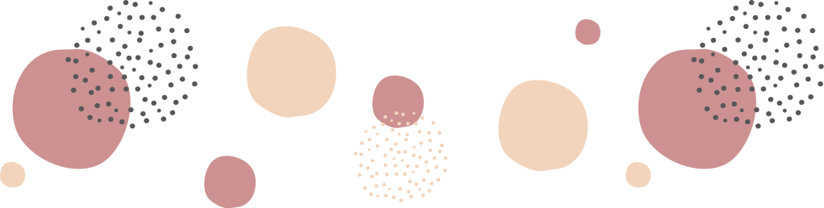
THANK YOU FOR YOUR ATTENTION!
QUESTIONS? (WE LOVE 'EM)
Prepared by Nancy Putri Anjani

Slide 15




REFERENCES
IELTSADVANTAGE.COM
ENGLISHPOST.ORG

Slide 16

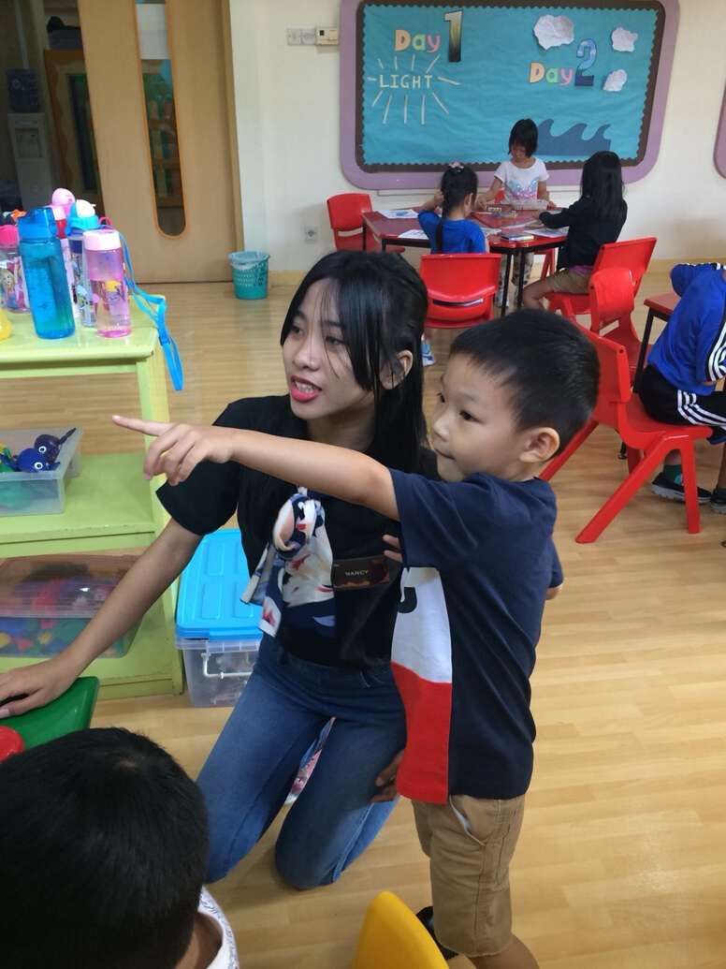


Thank You!
HAVE A BLESSED DAY
NANCY PUTRI ANJANI
English Language Pre-Service Teacher
@nancyanjani
nancyzandroto@gmail.com

